Slide 1
Talk 1: Amazing Grace
Jamie Vergara

Slide 2
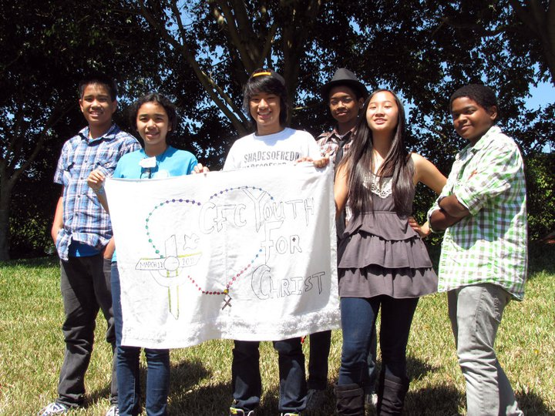
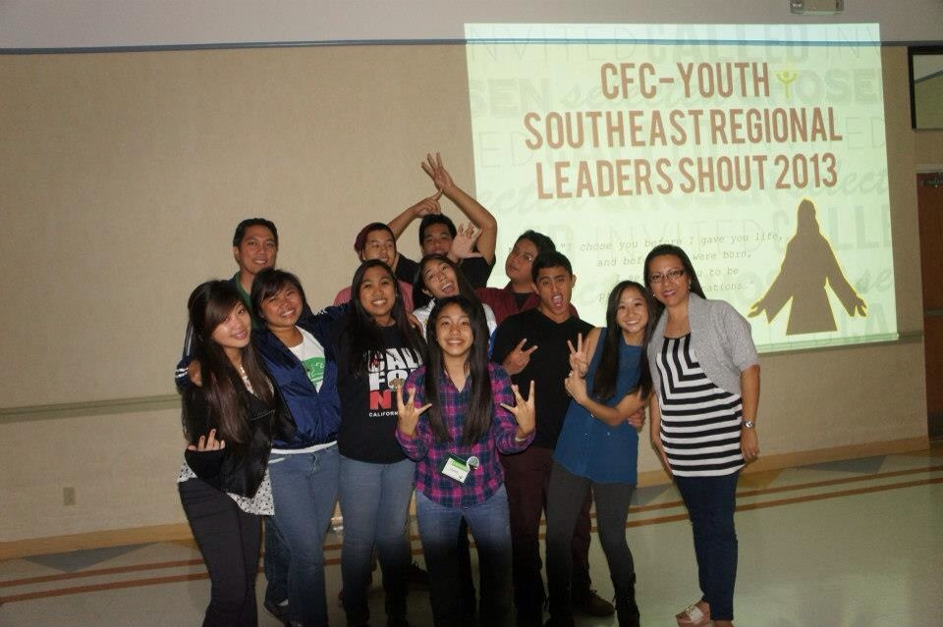
2011: My first youth camp
2013: My first SHOUT

Slide 3
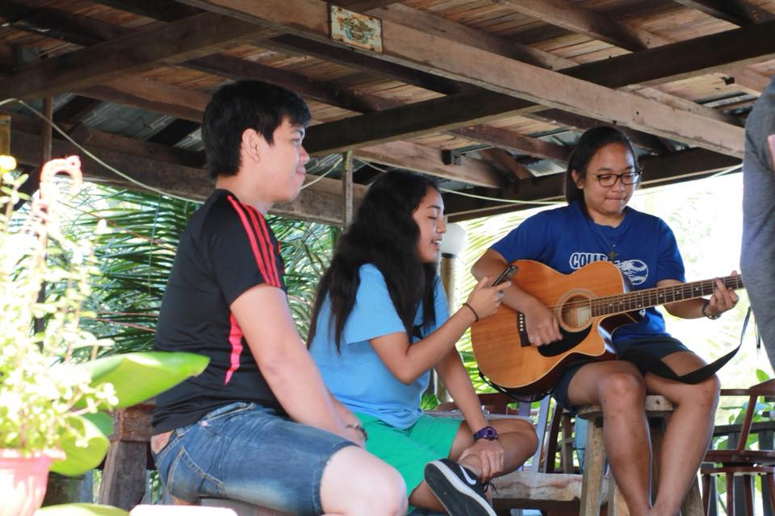
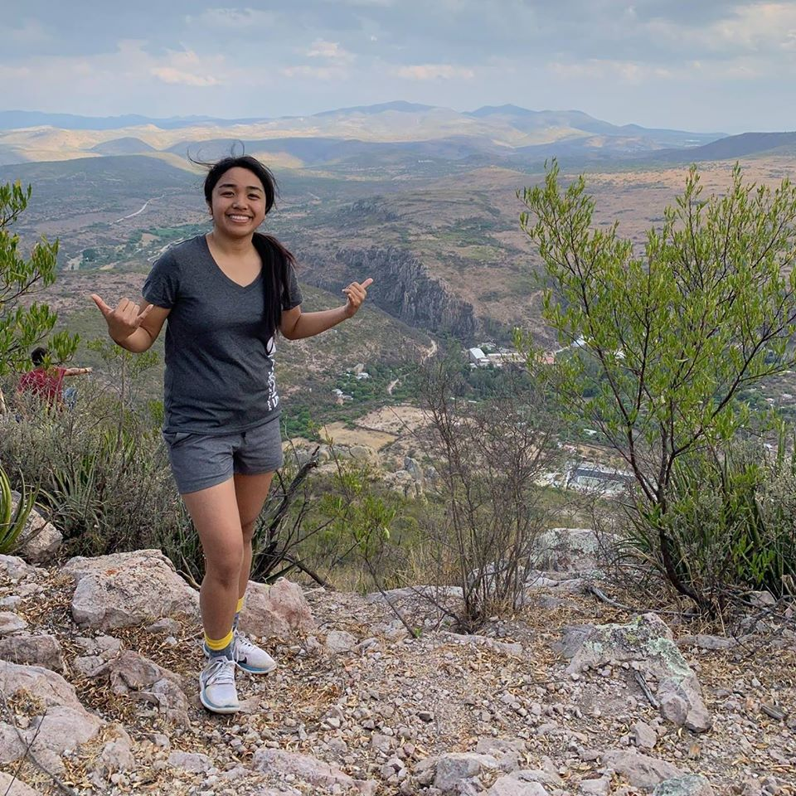
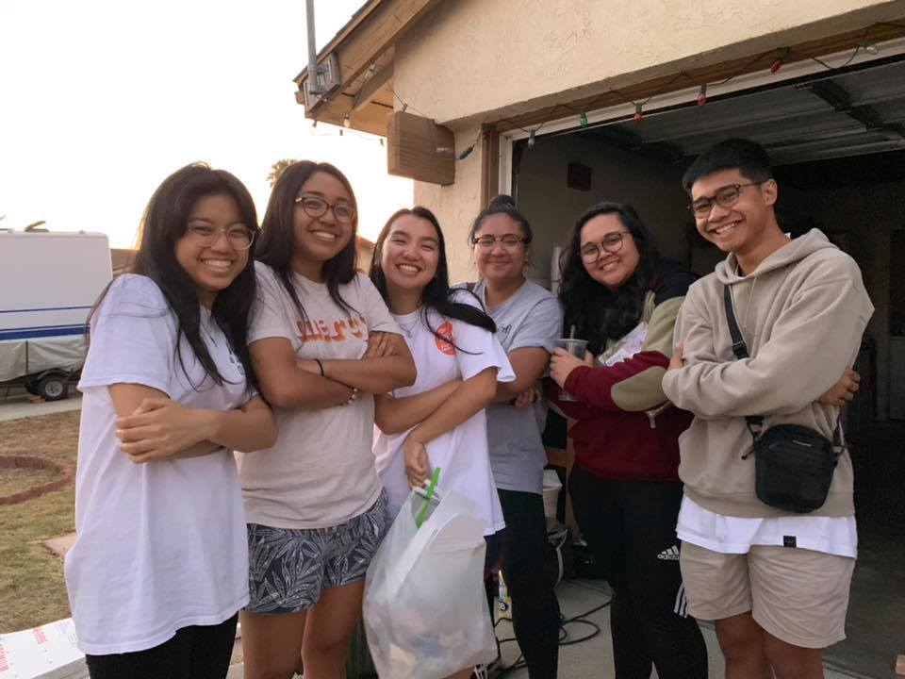
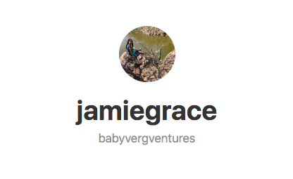
Fun

Slide 4
Freedom
Pope John Paul II said, “Freedom consists not in doing what we like but in having the right to do what we ought.”

Slide 5
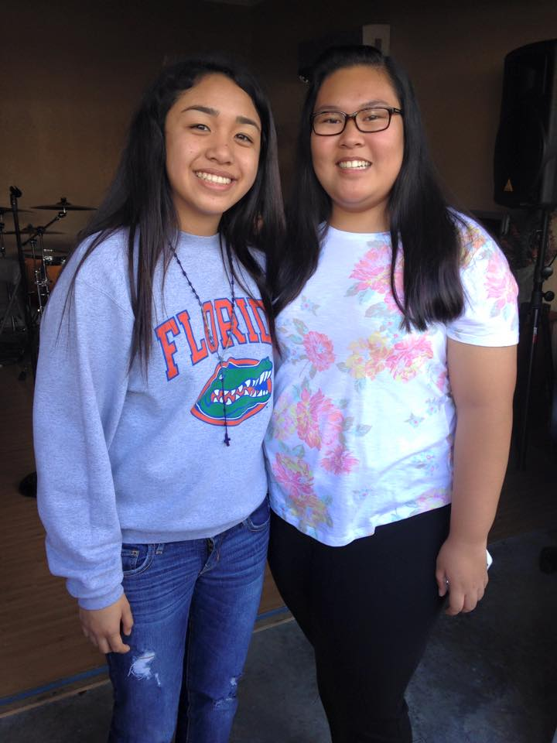
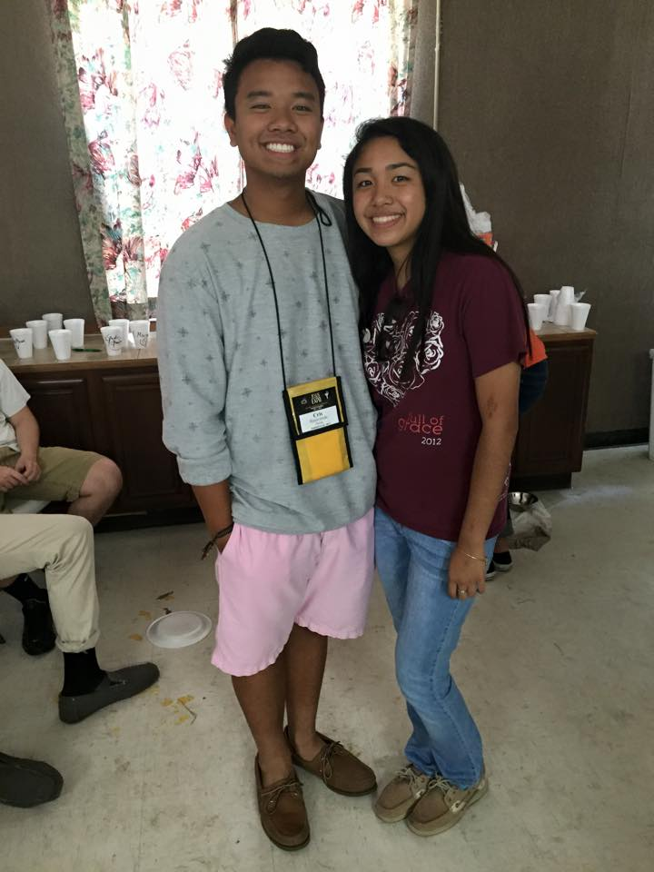
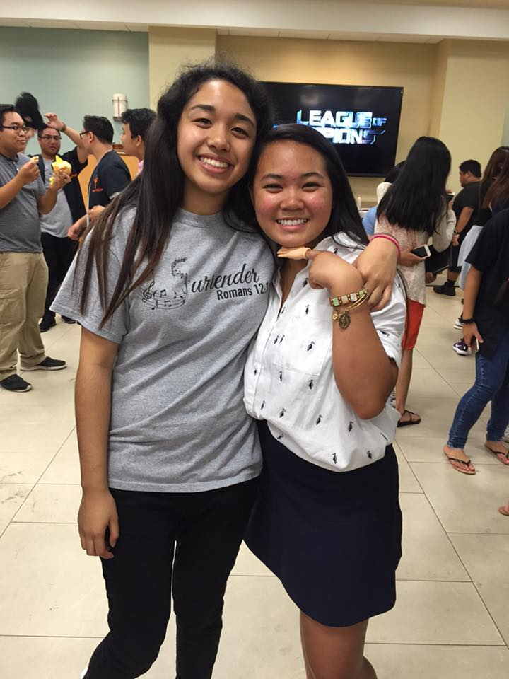
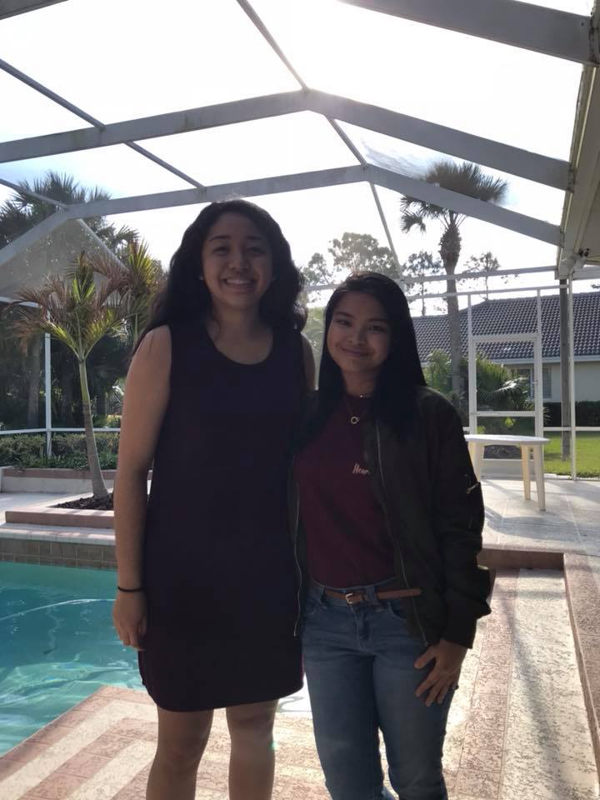
Friendship
2015
2015
2016
2018

Slide 6
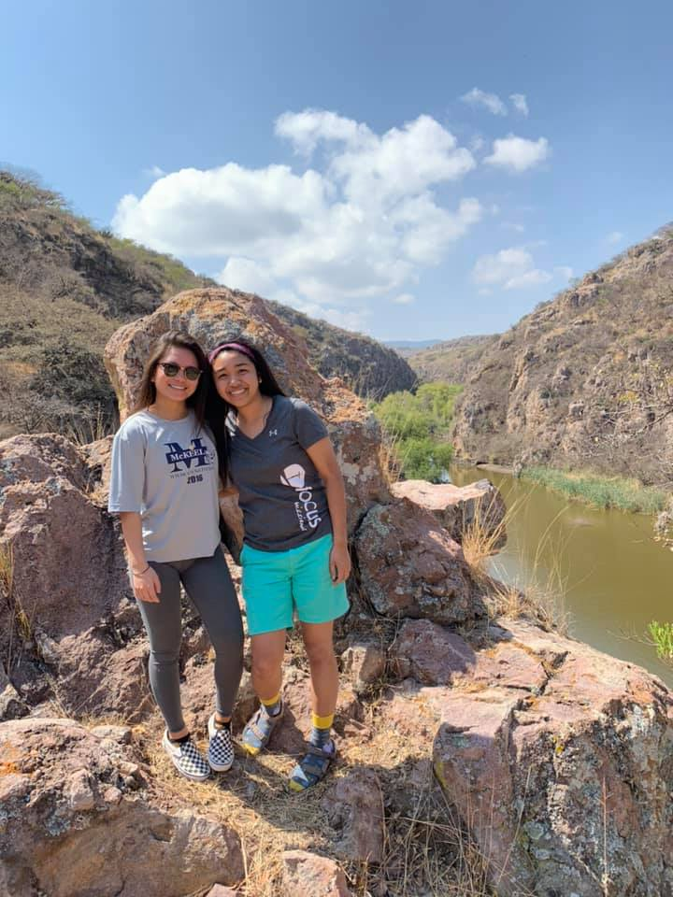
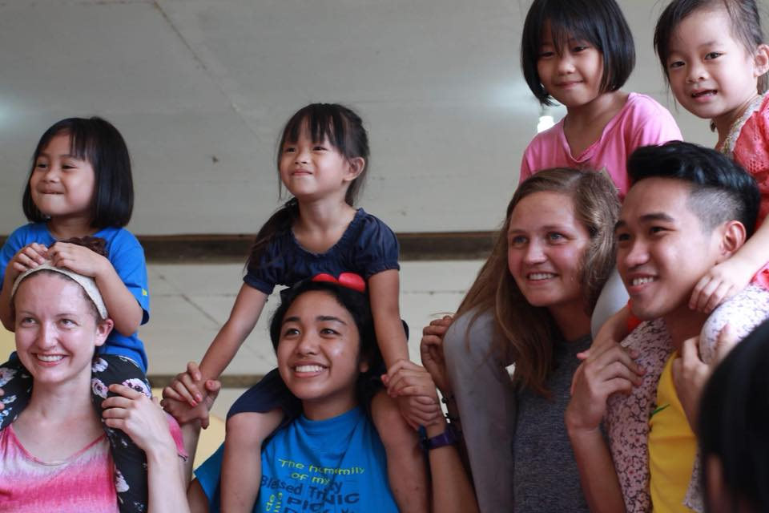
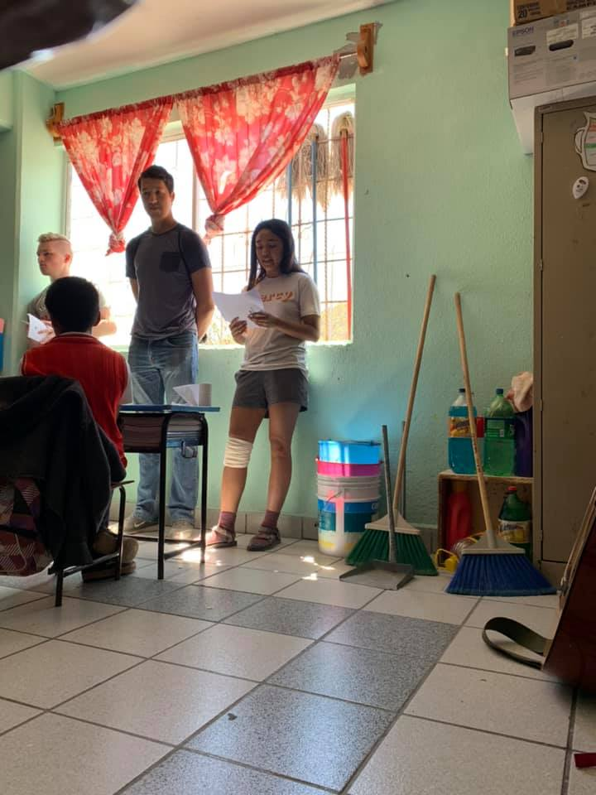
Faith

Slide 7


Amazing Grace of The Lord
“But as it is written: What eye has not seen, and ear has not heard, and what has not entered the human heart, what God has prepared for those who love him...” 1 Corinthians 2:9

Slide 8
Blessed to be loved and to love
“We love because God first loved us.” - John 4:19

Slide 9
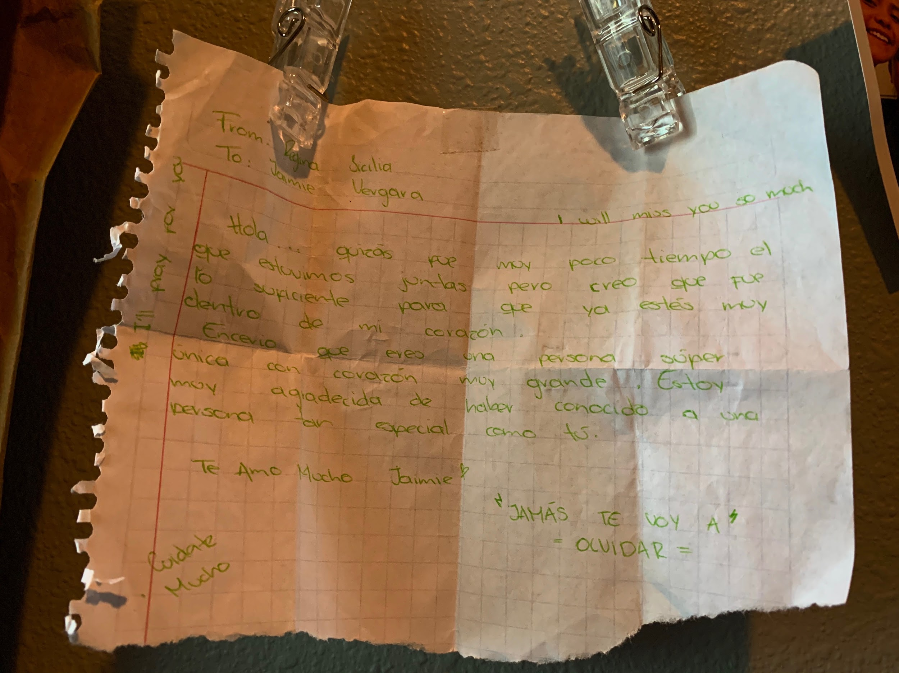
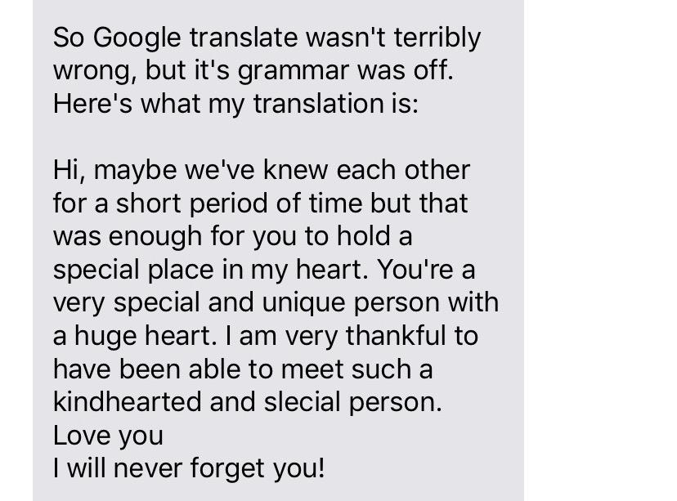
Blessed to Witness

Slide 10
“God said, ‘Not another day without you. I choose you. You are not an accident. Nothing about you is a mistake. You were always wanted.”
— Sister Bethany Madonna, Sisters of Life

